Slide 1
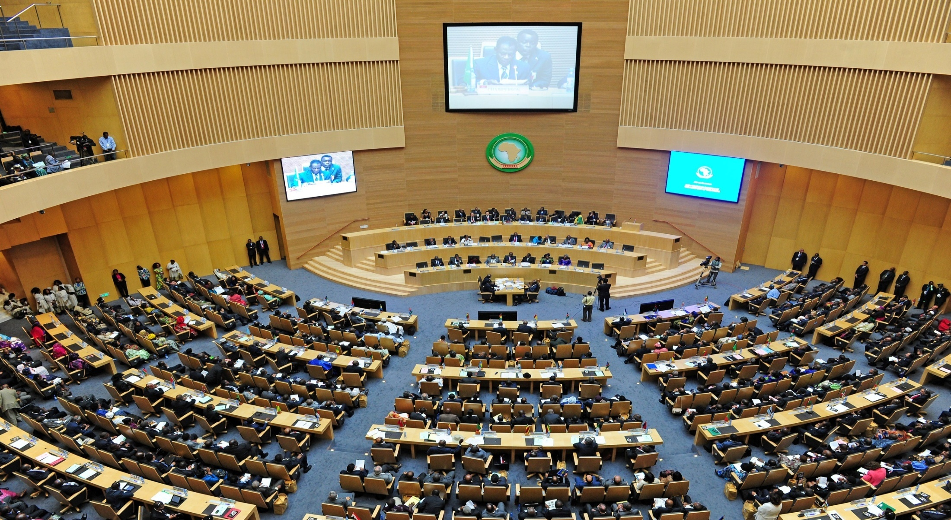
Current Trends in Teaching Diplomacy
Critical Competencies for a VUCA World
Ambassador Dr. Sameh Aboul-Enein ( EGYPT)

Slide 2
Navigating through volatility, uncertainty, complexity and ambiguity – Challenges of 21st Century Diplomacy
I) Introduction
Over the past two decades, the world witnessed great social, economic and political transformations due to a number of reasons- primarily the huge advancement in information technology which further fuelled globalization.
New emerging challenges such as cyber-security, climate change and international terrorism have effectively transformed the priorities of the International community & reset the global agenda.

Slide 3
Challenges of 21st Century Diplomacy
States and other international actors interact through the mechanisms of :
a)communication
b)negotiation
c)representation
All three functions of diplomacy have in the 21st century increasingly been challenged. There are more international actors, more channels and more issues to deal with, and naturally, these challenges need to be reflected in diplomatic training accordingly.

Slide 4
Challenges of 21st Century Diplomacy
new channels of communication available: what challenges does modern public diplomacy face, how important is intercultural communication? How can 21st century diplomats be prepared for e-diplomacy? What are the best approaches to deal with the overflow of information and data ?
more complex issues to be negotiated: how to deal with the challenge of integrating multiple issues into a coherent foreign policy? What are the best methods to train new generations of diplomats to effectively equip them with tools to successfully negotiate multilateral trade, climate change & cyber-security related agreements? And should 21st century diplomats rather be trained as specialists or as generalists?

Slide 5
II) Diplomatic training: Addressing the new challenges
Diplomatic training in the past was primarily concerned with further developing the new diplomats grasp of international relations, international law and foreign policy.
The current, fast-paced set-up of diplomacy and international relations necessitates equipping new diplomats with the needed tools to address the new challenges mentioned earlier.
Diplomatic academies and institutes have to systematically & scientifically upgrade their teaching methodologies from subject-based to skills-based, knowledge training, which simulates self-learn, character and capacity building .
The shift in the teaching paradigms can be done by focusing on developing the below sets of skills &competencies:-

Slide 6
III)Research Skills – Self-learning & Building of knowledge

Slide 7
Research Skills – Self-learning & Building of knowledge
The nature of diplomat's work involves movement across various departments within the Ministry and overseas and the handling of diverse portfolios in the process.
The overflow of information & the rapidly changing global trends create a new challenge for diplomats to adjust and develop accordingly.
Research skills is thus identified as a primary tool for diplomats to keep up with the emerging concepts, ideas and trends.
Research and analysis of information on issues and countries of interest is a necessity to provide quality and timely policy recommendations.

Slide 8
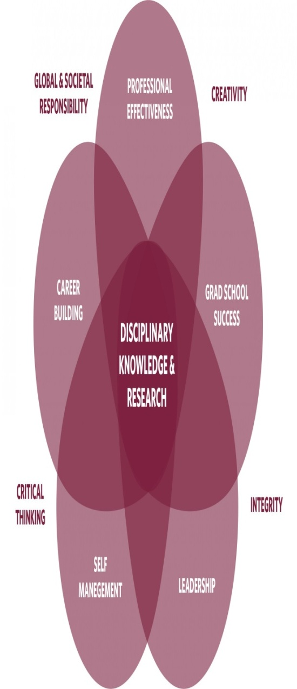
Research Skills – Self-learning & Building of knowledge
A recent study by the University of British Colombia placed research and disciplinary knowledge at the core of the skills needed for success .
Trainees at the Egyptian Institute for Diplomatic Studies submit a 15,000 words research paper/policy recommendation on issues of interest to the ministry as part of their training program. Additionally, they are required to submit other papers and prepare presentations on different topics to ensure that they acquired subject-related information and build their research and presentation skills.
Their research skills and abilities are thus upgraded due to the supervision of the researches by an expert academic / professional panel that work with them year-round on data-gathering, verification and analyses of present information.

Slide 9
IV) Technology & Communication – Diplomat's prime tools in the 21st century

Slide 10
Technology & Communication – Diplomat's prime tools in the 21st century
The huge advancement in the fields of information technology and communication is considered both a blessing and a curse. If utilized properly, the new communication platforms can be of great assistance for the new generation of diplomats.
Digital diplomacy – considered a derivative of public diplomacy – is gaining increased influence over the past few years.
There is a growing influence of social media platforms such as twitter that are utilized to help achieve diplomatic objectives and carry out foreign policies.

Slide 11
Technology & Communication – diplomat's prime tools in the 21st century
In IDS we provide every trainee with a basic training in the “Utilization of E-Diplomacy”, in order to equip every diplomat who is going to serve in an overseas mission with the necessary skills to navigate through social media platforms.
However:
Reflecting on the debate of generalization versus specialization in diplomatic corps, E-Diplomacy, a double-edged sword, is a matter that is better handled by experts specializing in the field to gain optimum results and to avoid critical errors.

Slide 12
V) Diplomacy through Networking: Interactive Diplomacy

Slide 13
Diplomacy through Networking: Interactive Diplomacy
The ability to create and maintain a professional network remains one of the core competencies diplomats need to possess.
An interrelated and outreaching web of contacts can be of great assistance to diplomats in achieving their mission and carrying out the set-objectives.
The Institute for Diplomatic Studies developed a module with a clear methodology to improve the new attaches networking skills.

Slide 14
Diplomacy through Networking: Interactive Diplomacy
In addition, IDS worked on creating new platforms & channels for dialogue between the attaches and their peers worldwide to effectively apply and practice their networking skills. In the process, the Institute organized two major training programs for African diplomats from Anglophone and Francophone countries that were attended by the Egyptian attaches. In addition, IDS organized a number of joint one-day workshops that were attended by foreign and Egyptian attaches.
IDS also worked on widening the scope of the attaches interaction to include diversified state institutions in order to familiarize the attaches with the interests and specific nature of different state’s institutions and diversify their network.

Slide 15
Joint Training programs: Francophone and Anglophone African Diplomats
Egyptian and African diplomats from Anglophone countries upon completion of the
2-weeks training program

Slide 16
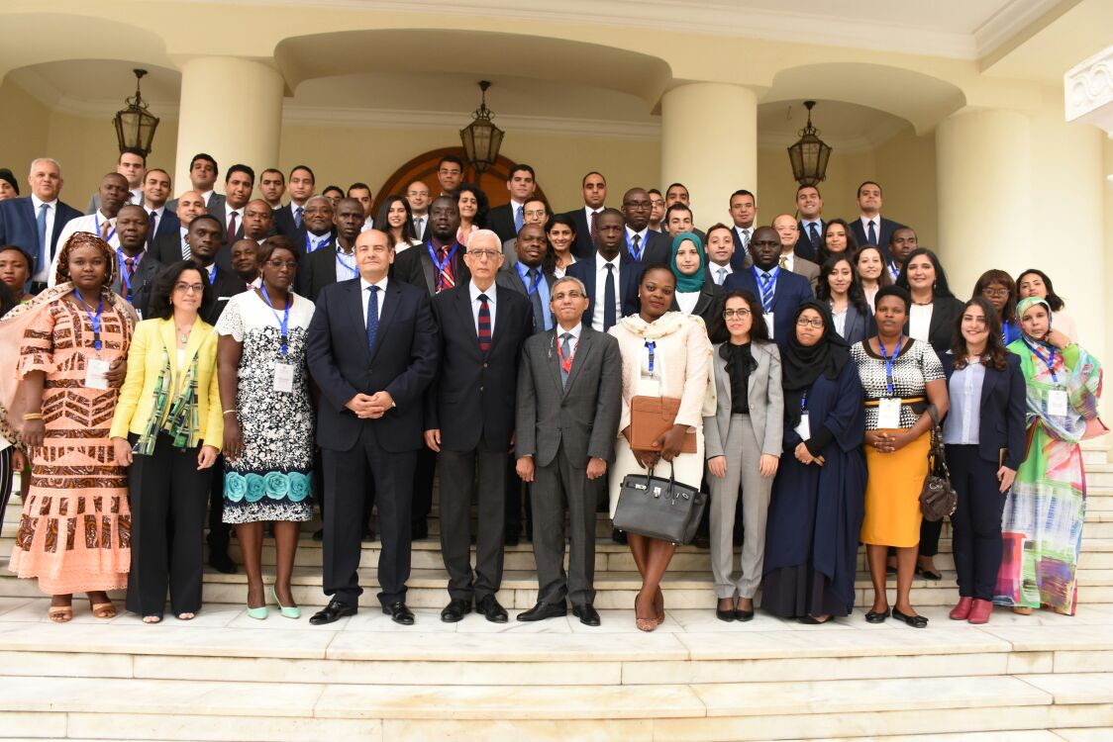
Joint Training programs: Francophone and Anglophone African Diplomats
Egyptian and African diplomats from Francophone countries upon completion of the
2-weeks training program

Slide 17
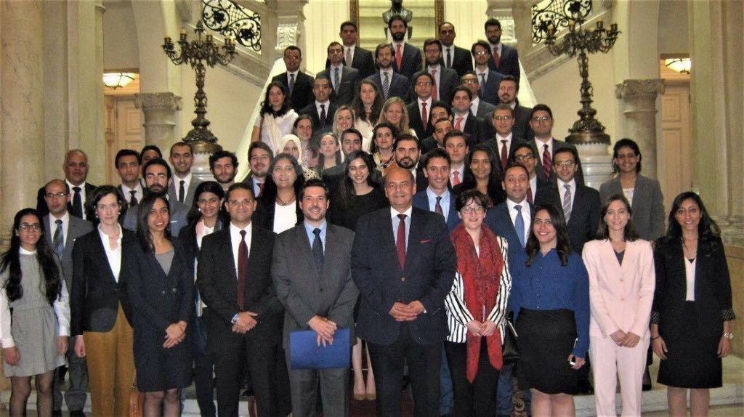
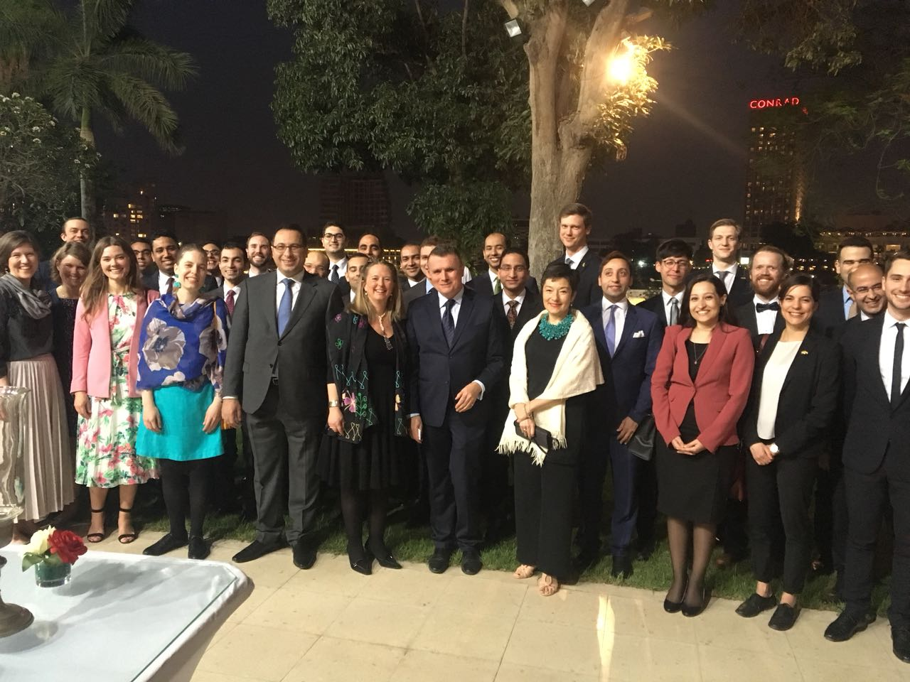
Diplomacy through Networking
Spanish delegation visit to the Institute
Egyptian and Swedish attaches at the Residency of the Swedish Ambassador during a reception

Slide 18
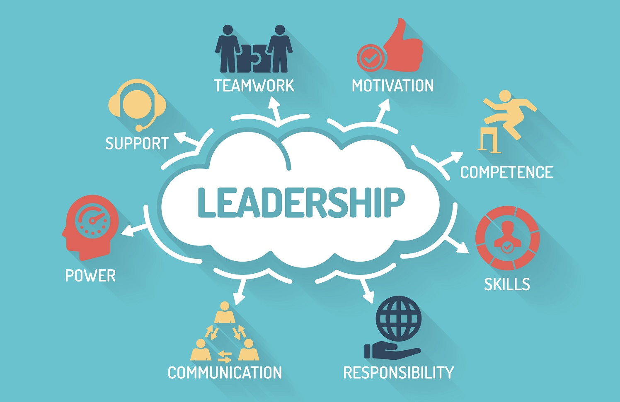
VI) Leadership in Diplomacy

Slide 19
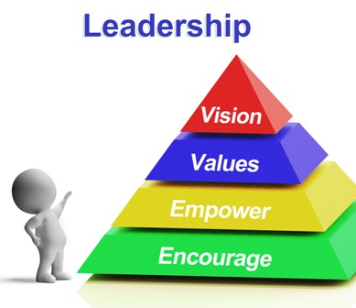
Leadership in Diplomacy
Leadership is considered to be one of the most important traits/skills in the field of diplomacy.
Along with presence & charisma, leadership is a prerequisite to excel especially in Multilateral Fora.
Diplomats with leadership qualities have a higher tendency to propose and carry out new initiatives and open new channels for cooperation with different stakeholders.
Diplomatic Institutes and academies should act as a “scout” to identify junior diplomats with natural leadership skills.

Slide 20
Leadership in Diplomacy
However, studies have proven that leadership skills can be significantly honed with a systematic approach & appropriate training and practice. The diplomatic training should thus incorporate character-building methodologies in the trainings provided.
The Institute for Diplomatic Studies develops this skill by providing the trainees with opportunities for growth & exposure.
IDS motivates and encourages trainees to present and carry out initiatives, thus contributing to increasing their creativity, which is cited in a number of studies as a crucial trait needed for leadership.

Slide 21
Thank you for your attention

